Slide 1
ALU Final Project
Tim, Clayton, Jordan, and Kenton

Slide 2
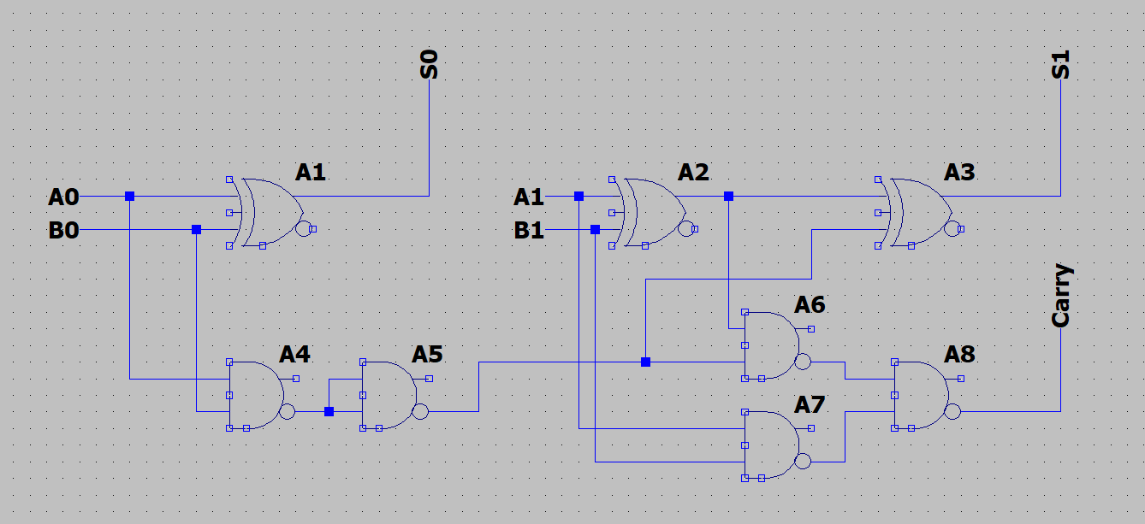
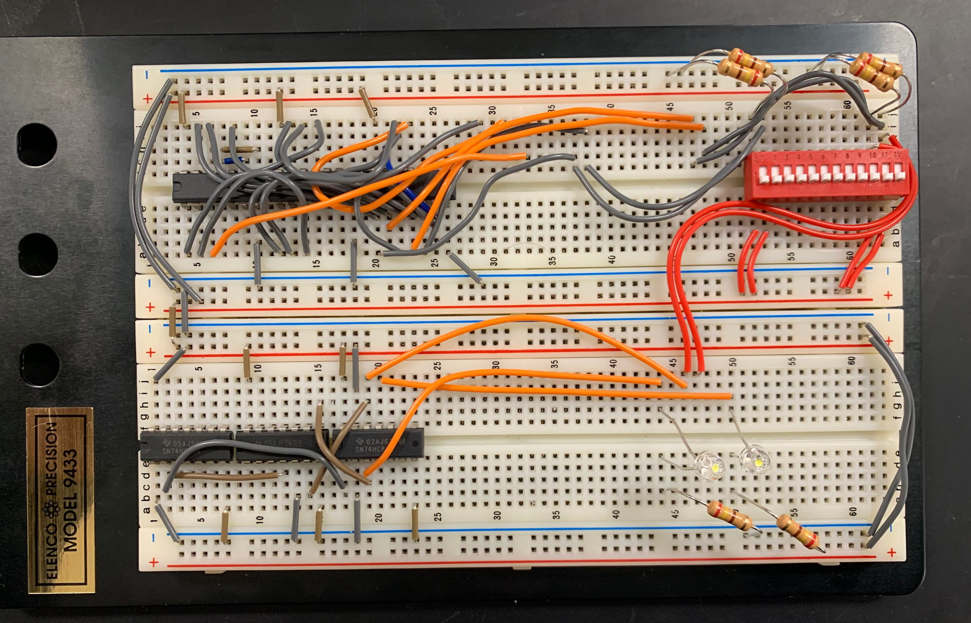
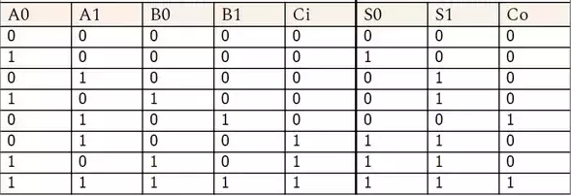
Adder- Clayton
For the 2-bit adder we started used one full adder and one half adder.
A0,A1,B0,B1 are inputs and S0,S1,Carry are the outputs
For this adder we used 3 XORs or 1 IC, and 5 NANDS or 2 ICS

Slide 3
Issues and what I learned?-Clay
My main issues were getting proper connections to work as well as translating the schematic to the ICs’
I learned a lot from this by reading and understanding data sheets.
I also learned the importance of maintaining an organized breadboard

Slide 4
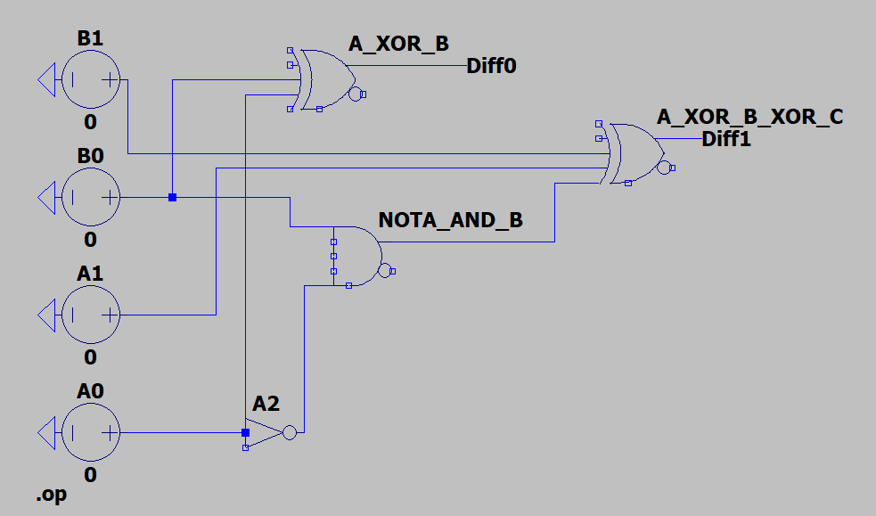
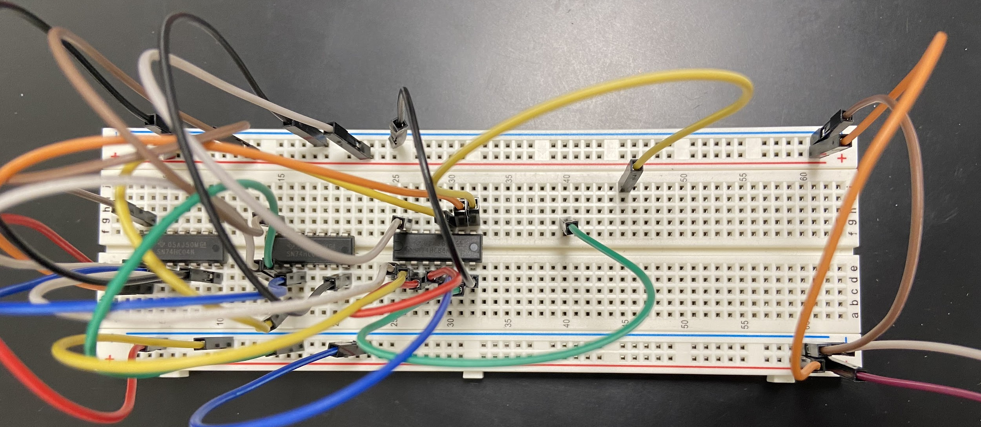
Subtractor- Kenton
B1, B0, A1, and A0 input bits
Half subtractor used for LSB (B0-A0)
Full subtractor used for MSB (B1-A1-Carry)
Three ICs used
XOR GATE
NAND GATE
INVERTER
Half Subtractor
D = A ⊕ B
B = ĀB
Full Subtractor
D = A ⊕ B⊕ C
B = ĀB + ĀC + BC

Slide 5
Issues and What I Learned - Kenton
My original design used multiple NAND and NOR ICs
I learned to reduce the equations using XOR gates
This change made the circuit much smaller and easier to troubleshoot
I learned to research multiple designs for ideas
I had a couple bad breadboard nodes and jumper wires
I learned to try multiple nodes when approaching a stubborn problem
I learned better breadboard node management

Slide 6
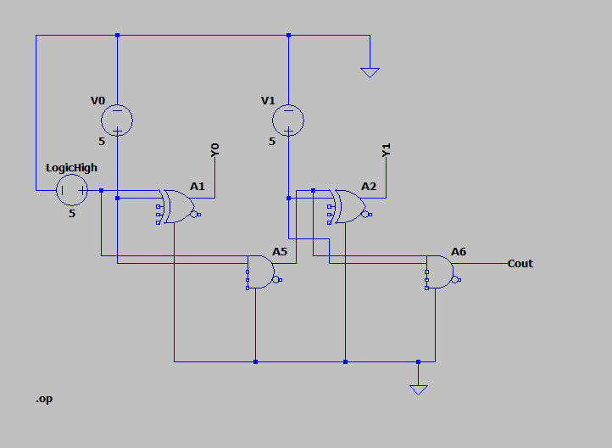
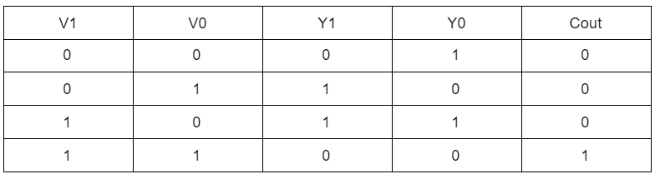
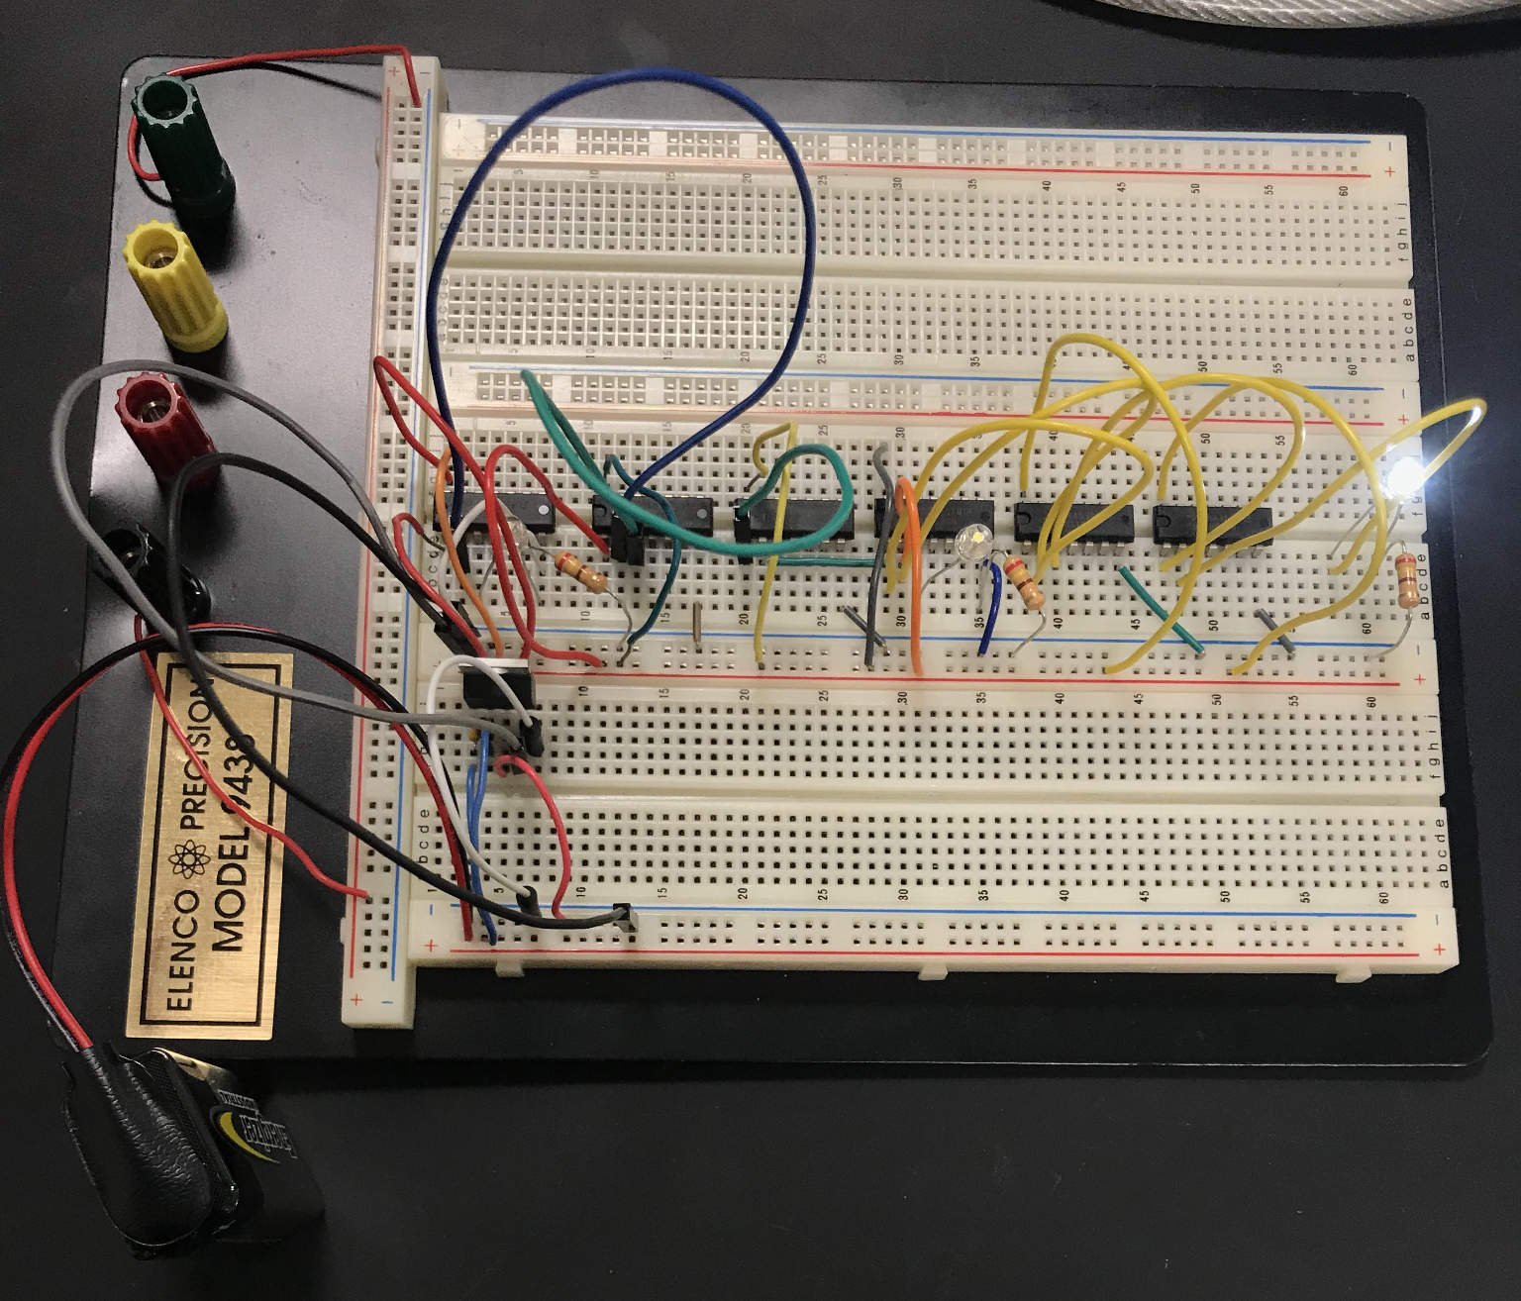
Incrementer- Tim
V1 and V0 are inputs with V1 being the MSB
Y1 and Y0 are outputs with Y1 being the MSB
To build the circuit on the breadboard, an XOR, NAND, and inverter IC were used
The output of each NAND was inverted to get the same result as using an AND gate
All other connections are self-explanatory using the IC datasheets
A correct output is the input plus one

Slide 7
Issues and What I Learned -Tim
I accidentally used 6 ICs because I forgot that each could take multiple inputs
I did not struggle with anything until I tried to connect the incrementer to the switch
Checking wire connections ended up being the solution to the problem
I learned how to struggle in this lab
Also learned how to read datasheets and use IC chips
My biggest takeaway was my improvement and understanding of breadboarding
I learned how to have a healthy mind

Slide 8
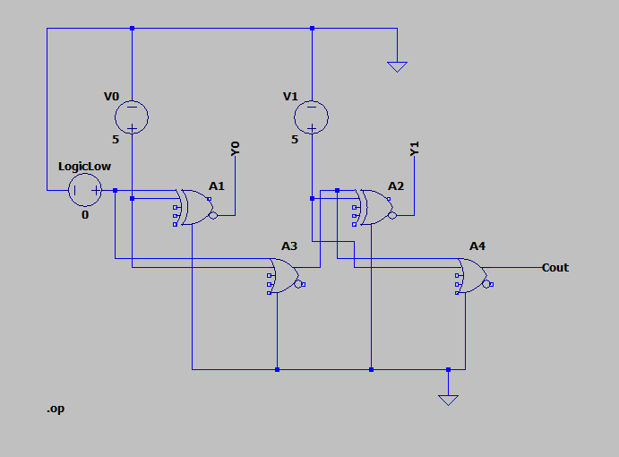
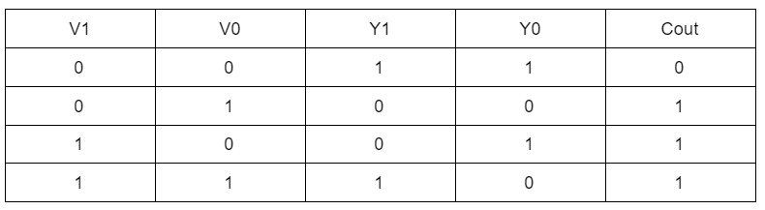
Decrementer- Tim and Clayton
V1 and V0 are inputs with V1 being the MSB
Y1 and Y0 are outputs with Y1 being the MSB
To build the circuit on the breadboard, an XOR, NOR, and inverter IC were used
The output of each NOR was inverted to get the same result as using an OR gate
All other connections are self-explanatory using the IC datasheets
A correct output is the input minus one

Slide 9
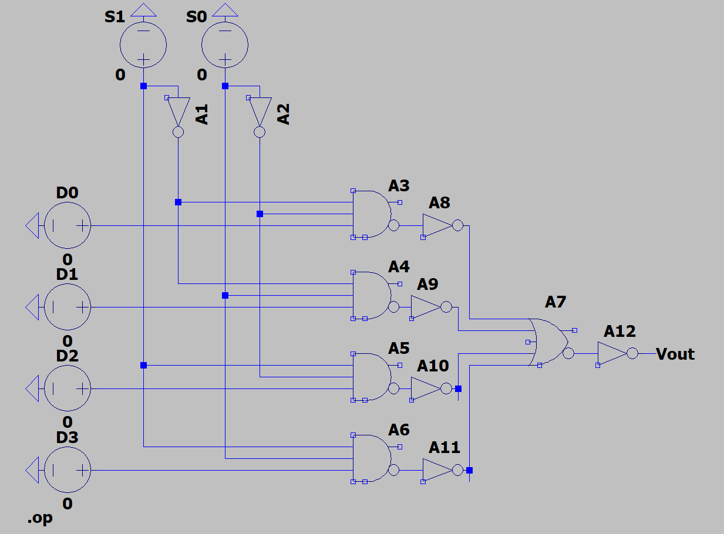
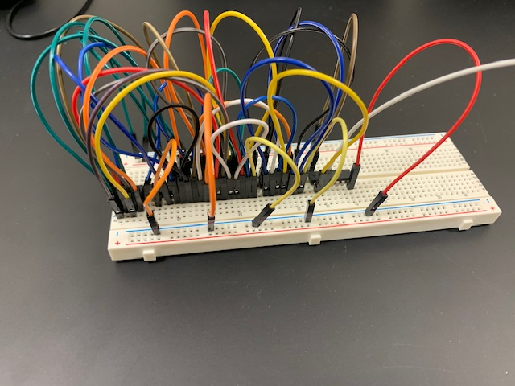
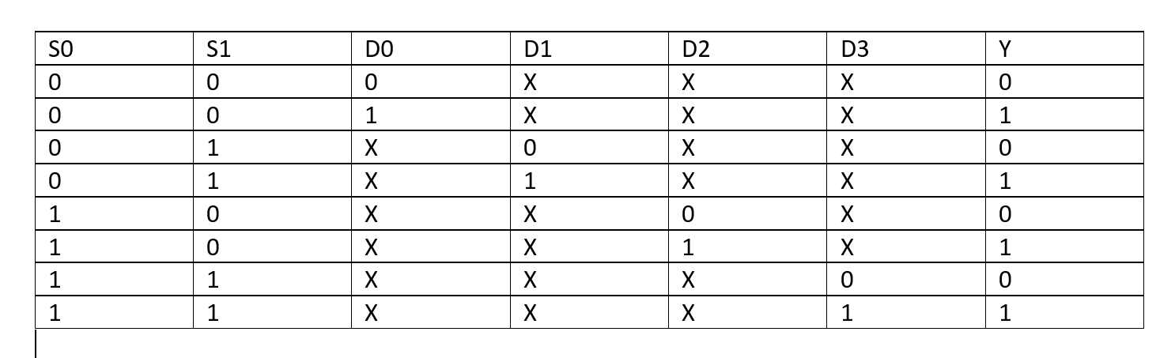
Multiplexer- Jordan
S1 and S0 are the select switches
D0-D3 represent the adder, subtractor, incrementer, and decrementer.
In the simulation, 2 inverse gates, 4 AND gates, and 1 OR gate are used.
To model on the breadboard, 2 inverse IC’s, 2 NAND IC’s, and 1 NOR IC are used.
The breadboard inverts to operation to match the simulation.

Slide 10
Issues and What I Learned- Jordan
Issues:
IC issues with a high of 4V and a low of 1V
Keeping the circuit working for a long period of time
What I learned:
How a MUX functions
Better understanding of IC’s
Improved skills with the breadboard

